Slide 1
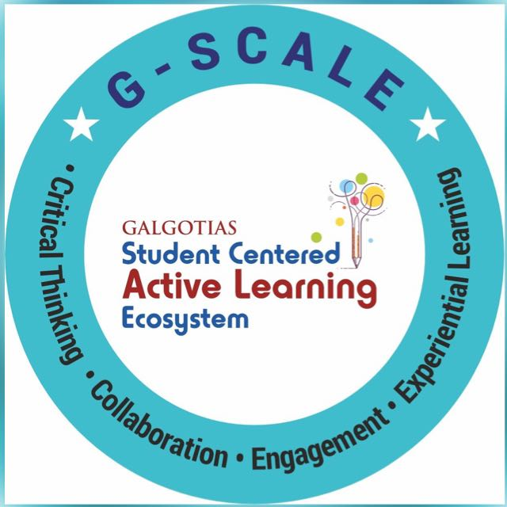
Basic Concepts of Natural Language Processing Session No.: 1 Course Name: Natural Language Processing Course Code: R1UC616C Instructor Name: Dr. Deepa Joshi Duration: 50 mins Date of Conduction of Class: 4 March 2025

Slide 2
How does your phone’s voice assistant, like Siri or Alexa, understand and respond to your commands as if it ‘knows’ what you mean?

Slide 3
At the end of this session, students will be able to
Explain the fundamental concepts of Natural Language Processing (NLP) and its relationship with computational linguistics, highlighting their role in human-machine communication.

Slide 4
What is Natural Language Processing (NLP)?
Natural Language Processing (NLP) is a subfield of Artificial Intelligence (AI) and Computational Linguistics that focuses on the interaction between computers and human (natural) languages. It involves the development of algorithms and models that enable machines to process, understand, generate, and respond to text or speech in a meaningful way.
Examples of NLP in everyday life:
Virtual Assistants & Chatbots
✅ Examples: Siri, Alexa, Google Assistant, ChatGPT ✅ Use Case: Voice commands, answering questions, setting reminders, and executing tasks.
Search Engines
✅ Examples: Google Search, Bing, Yahoo ✅ Use Case: Autocomplete, intent recognition, and ranking relevant search results.
Machine Translation
✅ Examples: Google Translate, DeepL, Microsoft Translator ✅ Use Case: Converting text from one language to another in real-time.
Sentiment Analysis
✅ Examples: Twitter Analytics, Brand Monitoring, Customer Reviews
✅ Use Case: Understanding public opinion on social media, customer feedback, and market trends.

Slide 5
5. Grammar & Spell Checking
✅ Examples: Grammarly, Microsoft Word, Google Docs
✅ Use Case: Auto-correcting grammar mistakes and improving sentence structure.
6. Speech Recognition & Voice Typing
✅ Examples: Google Speech-to-Text, Apple Dictation, Dragon NaturallySpeaking
✅ Use Case: Converting spoken words into text for transcription and voice commands.
7. Automated Customer Support
✅ Examples: AI-powered chatbots in banking, e-commerce, telecom ✅ Use Case: Handling customer queries, troubleshooting, and reducing human workload.
8. Healthcare Applications
✅ Examples: AI medical chatbots, Clinical documentation (Nuance, IBM Watson)
✅ Use Case: Automating medical record transcription, symptom checking, and personalized health advice.
9. Financial & Legal Document Processing
✅ Examples: AI-driven contract analysis (ROSS Intelligence, Kira Systems)
✅ Use Case: Extracting key information from legal and financial documents, reducing manual review time.

Slide 6
Why is NLP Challenging?
Natural Language Processing (NLP) is difficult because human language is complex, ambiguous, context-dependent, and constantly evolving. Unlike simple keyword matching, NLP requires machines to break down text, extract meaning, and interpret context using advanced computational techniques.
How NLP Overcomes These Challenges?
✅ Word Embeddings (Word2Vec, GloVe, BERT, GPT-3) – Help capture word meanings based on context. ✅ Transformer Models (BERT, GPT-4, T5) – Consider the entire sentence instead of isolated words. ✅ Coreference Resolution & Dependency Parsing – Identify references and sentence structures. ✅ Transfer Learning & Continuous Training – Keep NLP models updated with new words and trends.

Slide 7
Activity 1: why NLP is challenging?
Instructions:
Divide the class into small groups
Each group will complete the following five tasks and discuss their observations.
At the end, each group will present their findings.
Task 1: Ambiguity in Language
📌 Objective: Recognize how the same sentence can have multiple meanings.
Step 1: Read the following sentences and list at least two possible interpretations for each.
"I saw her duck."
"The chicken is ready to eat."
Step 2: Discuss in your group:
How does a human decide the correct meaning?
Why would an AI struggle with this?

Slide 8
Task 2: Understanding Context Dependence
📌 Objective: Learn how meaning depends on prior information.
Step 1: Read the following short phrases and guess what they mean without any additional context.
"That was a piece of cake!"
"She is on fire today."
"Let’s break the ice."
Step 2: Now, read the full sentence in which each phrase appears:
"The math test was a piece of cake!"
"She is on fire today with her basketball skills."
"At the party, we played a game to break the ice."
Step 3: Discuss:
Why did the meaning become clearer with context?
How do machines handle this type of challenge?

Slide 9
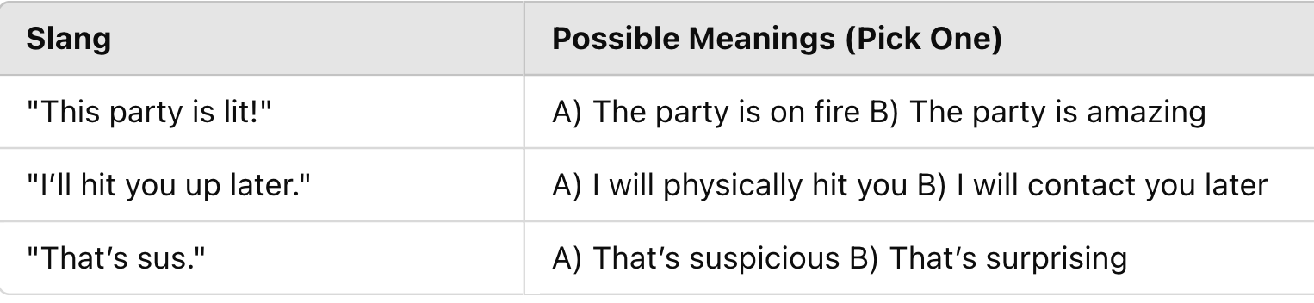
Task 3: Evolving Language – New Words & Slang
📌 Objective: Experience how NLP struggles with new and informal language.
Step 1: Match each modern slang phrase with its meaning.
Step 2: Discuss:
If an AI model was trained only on books from the 1990s, would it understand these terms?
How do NLP models keep up with new words?

Slide 10
Task 4: Resolving Pronoun Confusion
📌 Objective: Understand how NLP struggles with pronoun references.
Step 1: Read the sentences below and determine who the pronoun refers to.
"John called Mike because he was late." (Who was late—John or Mike?)
"Lisa told Sarah she lost her book." (Who lost the book—Lisa or Sarah?)
"Alex and Jamie went hiking. He reached the top first." (Who reached first—Alex or Jamie?)
Step 2: Discuss:
How do humans figure this out easily?
What methods might machines use to resolve this issue?

Slide 11

Ensure attainment of LOs in alignment to the learning activities: outcomes (1-2)
Outcome 1: Explain the Fundamental Concepts of NLP and Its Relationship with Computational Linguistics

Slide 12
Information to next topic of the course
How Machines Process Language: Text Preprocessing (Cleaning the text: Tokenization, Stopword Removal, Lemmatization)

Slide 13
Activity 1 Discussions
Task 1- Possible Interpretations:
"I saw her duck."
(A) I saw her pet duck (animal).
(B) I saw her quickly lower her head to avoid something.
"The chicken is ready to eat."
(A) The cooked chicken is ready for a person to eat.
(B) The chicken itself is ready to eat food.
Ambiguity arises when words or sentence structures have multiple meanings. Humans resolve ambiguity using context, but NLP models must rely on algorithms and training data.

Slide 14
Task 2: Understanding Context Dependence
📌 Before Context:
"That was a piece of cake!" → Literal meaning: a piece of dessert.
"She is on fire today." → Literal meaning: She is burning.
"Let’s break the ice." → Literal meaning: Physically breaking ice.
📌 After Adding Context:
"The math test was a piece of cake!" → The test was very easy.
"She is on fire today with her basketball skills." → She is performing exceptionally well.
"At the party, we played a game to break the ice." → Starting a conversation to make people feel comfortable.
✅ Key Takeaway: Context drastically changes meaning. NLP models need to analyze surrounding words and prior sentences to infer meaning correctly.

Slide 15
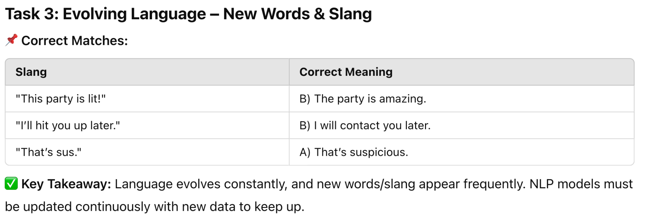

Slide 16
Task 4: Resolving Pronoun Confusion
📌 Correct Answers:
"John called Mike because he was late." → Ambiguous, but likely means Mike was late.
"Lisa told Sarah she lost her book." → Ambiguous, could mean Lisa or Sarah lost the book.
"Alex and Jamie went hiking. He reached the top first." → Ambiguous, unclear whether Alex or Jamie reached first.
✅ Key Takeaway: Humans use common sense and prior knowledge to resolve pronouns. Machines use Coreference Resolution to track entities in a sentence.

Slide 17
Conclusion
Definition of NLP:
NLP is a branch of AI that enables machines to process, understand, and generate human language.
It helps computers interact with humans in a natural way.
✅ Challenges of NLP:
Ambiguity: Words and sentences can have multiple meanings.
Context Dependence: The same word can have different meanings based on context.
Evolving Language: New words, slang, and trends require continuous model updates.
Pronoun Resolution: Machines struggle to determine references in sentences.
Understanding Sarcasm & Emotions: Machines find it hard to detect tone and hidden meanings.
✅ Applications of NLP:
Chatbots & Virtual Assistants: Siri, Alexa, Google Assistant.
Search Engines: Google Search, Auto-complete, and intent recognition.
Machine Translation: Google Translate, multilingual AI systems.
Social Media Monitoring: Sentiment analysis for brands and trends.
Grammar Checking & Text Correction: Grammarly, Microsoft Word spell check.
Text Summarization & Q&A Systems: AI-powered news summaries, automated customer support.

Slide 18


Review and Reflection from students

